Slide 1

Gun Violence in the US
Team 5 Haonan Zhang, Luping Zhao, Rocky Ye, Nancy Zhang, Siqi Li

Slide 2
Motivation
The right to bear arms is protected by the second amendment of the constitution.
400 million guns are in civilian possession. More than one gun per person on average.
2017 shooting at a music festival in Las Vegas that killed fifty-eight people.
2018 shooting at a high school in Parkland, Florida, that killed seventeen people.
Dataset
Source: gunviolencearchive.org
Provider: Gun Violence Archive (GVA)
Data size: over 200k US gun violence incident records from 2014-2017

Slide 3
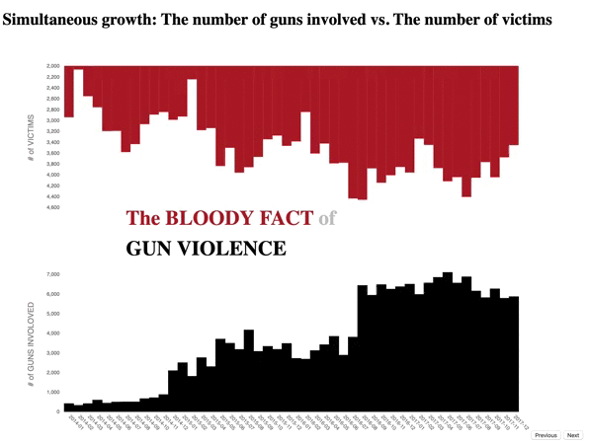
Design
Place your screenshot here
Hue
Black: coordinate with the serious topic
Red: utilize the color of blood
Animation
Emphasize the increase of the # of guns involved
Present death and injury with the "bleeding"
Layout
Inversed the upper bar chart to create a narrowing white spate, intended to generate a depressing feeling
Adjusted the y-axis to make the bar charts "mirrored"
Insight
Insight
The number of victims and the number of guns involved increased simultaneously
The number of victims has a significant seasonal effect

Slide 4
Choropleth Map – Total Number of Victims by State
Design Choice
An interactive choropleth map to visualize the geographical distribution of the total number of gun violence victims
Color Choice
As gun violence is a heavy topic, we choose grey as our color palette. The darker the shade of grey, the higher the number of gun violence victims.
Interactivity
Users can know more about gun violence in states they are interested in. A tooltip will appear and show with specific statistics regarding that state

Slide 5
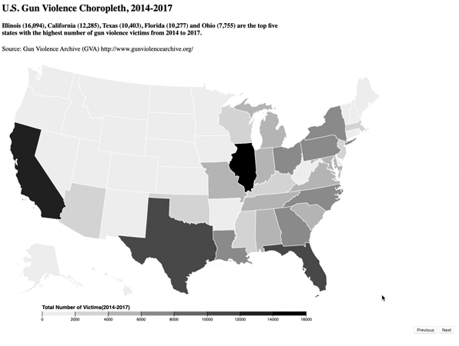
Once users hover their mouse on top of a state, the state will be highlighted.
A tool tip will appear and provide users with more detailed statistics regarding that state
Place your screenshot here

Slide 6
Bar Chart - Percentage increase in the number of victims
Color
Colors of individual bars represent the magnitude of the increase. The darker the shade of grey, the higher the percentage increased.
Order
The bar chart is sorted in a descending order. This allows readers to know which states had the highest increase in the number of victims.

Slide 7
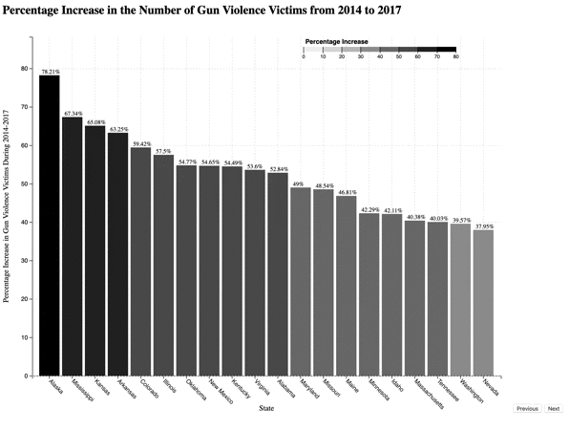
Animated Bar Chart
Text labels shows the exact percentage number
Place your screenshot here

Slide 8
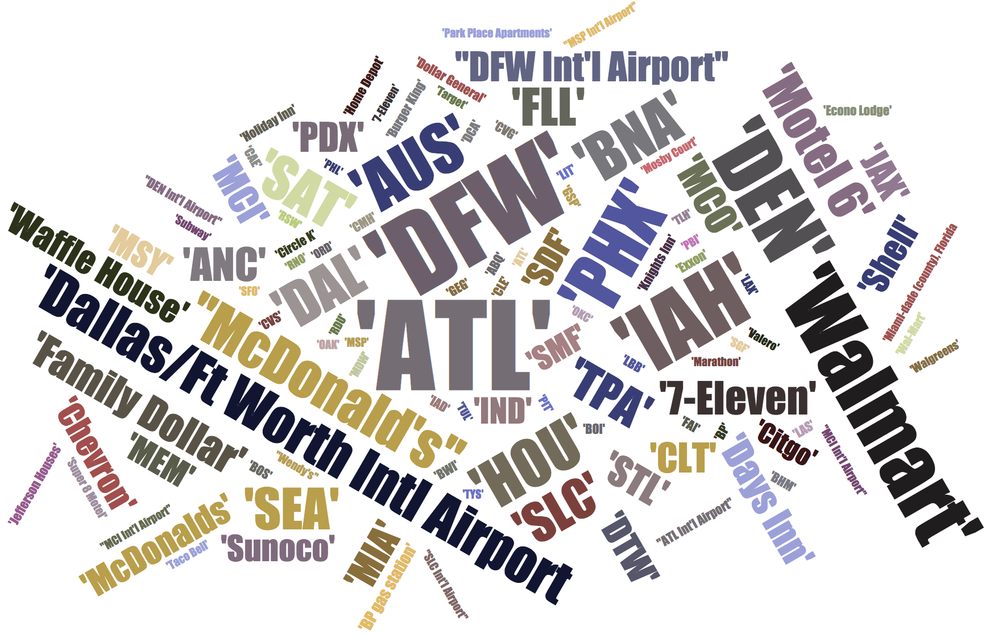
Word Cloud – Most Dangerous Places with Gun Violence
The larger the font size, the more frequent the gun violence occur at this place
Top 5 Places: Airports, grocery stores, fast-food restaurants, motels and gas stations
TSA actions account for more than 80% of the gun violence at airports
*We selected word cloud in 2016 for presentation purpose.
The word clouds for other years are in the html presentation

Slide 9
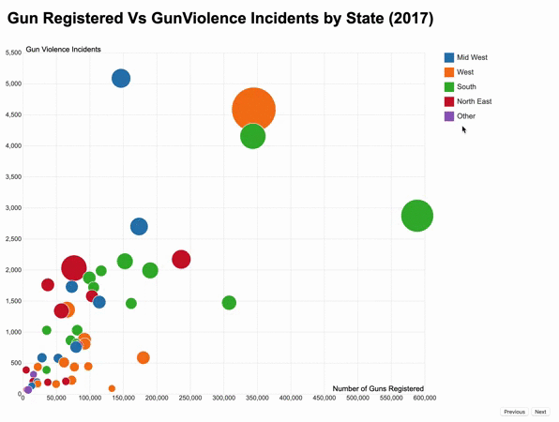
Design
Place your screenshot here
Hue
Region of each state
Size
Population of each state
Y
Gun violence incidents
Layout
Number of guns registered
Insight
Insight
You can manipulate the data to tell a different story
Gun incidents are correlated with total number of guns registered but not number of guns per capita

Slide 10
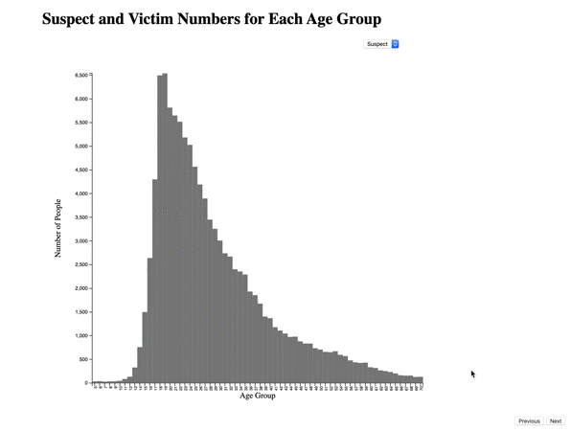
Age groups of victims
Age groups of suspects
Teenagers are most likely to be involved in gun violence
Place your screenshot here

Slide 11
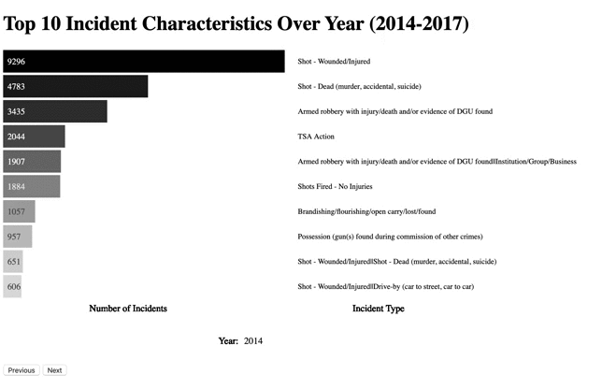
Design
Place your screenshot here
Hue
Black: coordinate with the serious topic
Animation
Emphasizes change of incident type across years
Layout
Bars with count of incident happened within each each year is shown on the left; the upper bound is the maximum number of count occurred that year and other bars' length are adjusted accordingly
Names of incident type are shown on the right with corresponding year indicated at the bottom
Insight
Insight
Injuries and deaths caused by shot are top two incident characteristics across years
Some other popular characteristic include non-shooting incident such as TSA Action and armed robbery

Slide 12
Insights
The study recognizes the bloody fact of gun violence and see positive correlation between number of victims and number of guns involved
Risky regions such as Illinois and California require special preventative action and surveillance, reducing potential negative gun violence stimulus
Juveniles account for large proportion, and better education and positive reinforcement would incentive them toward the right direction

Slide 13

Thanks For Listening

